Slide 1
Kalakal:
A B2B Wholesale Ecommerce Platform
By Group 2

Slide 2
Introduction
This project aimed to develop a B2B Wholesale E-commerce platform to provide an easier process of buying or selling of goods to business. Kalakal will support all processes from inventory to sales both for the vendors and customers. hence, It will lessen the time and effort of transactions. The system is developed using PHP as its main programming language, Codeigniter as its web framework, mySQL for the backend, and Bootstrap as its front-end framework

Slide 3
Problem Diagnosis
Commerce for small business inside and outside the metro has always been manual
Buyers need to physically go to the vendors location to purchase the goods
The goods are then brought to tracking services for the transportation of goods to the buyer’s location

Slide 4
Objectives
Develop an e-commerce platform for wholesalers and consumers for buying and selling of goods
Develop an integrated POS and Inventory System for each vendor accounts
Develop a tracking system for the delivery of goods

Slide 5
Target Audience
Wholesalers - The platform will be useful for keeping track of inventory, sales and customers
Business Owners - The platform will be useful for buying wholesale products online.
Manufacturers - The platform will be useful in introducing new products to potential customers
Tracking Services - The platform is useful for keeping track of deliveries and delivery requests.

Slide 6
Features
An online store for wholesalers and manufacturers
A web portal of wholesale products for business owners
A POS and Inventory Module for keeping track of sales and inventory
A tracking module for delivery request and tracing of deliveries

Slide 7
Scope
The platform is only for management of goods provided by the vendors
The platform will create an online store that will contain all the products registered in the system

Slide 8
Tools
Project - Management: Github
Repository Link: https://github.com/kyleaquino/WebDev_Project.git
Client-Side Scripts: HTML, CSS, Javascript
Server-Side Scripts: PHP, MySQL
Frameworks (Client-Side/Server-Side): Codeigniter, Bootstrap

Slide 9
Software Development Team

Slide 10
System Analyst
Aquino, Kyle Shaun

Slide 11
Programmer
Antiquando, Aaron Mark

Slide 12
Programmer
Pepito, Nicail

Slide 13
Front-End Developer
Saguion, Shaina

Slide 14
Back-End Developer
Muncada, John Paul

Slide 15
Quality Assurance
Dela Cruz, Bia

Slide 16
Documentation
Evangelista, Elisha

Slide 17
Plan of Work
The System will be using Agile development to start the web project
Kalakal: A B2B Wholesale Ecommerce Platform

Slide 18
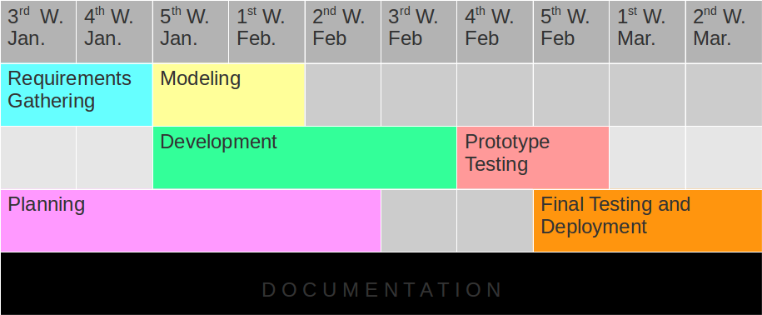
Gantt Chart

Slide 19
Communication
The system will be brainstormed and deliberated by the development team
Updates and Modifications will be done after the end of the development cycle
Prototype will be tested by chosen users and shall deliver necessary reports on the improvement of the system

Slide 20
Planning
The planning team composed of System Analyst, Frontend and Backend Developers will be collecting the data necessary to the development of the application and compile it in a more logical manner
The documentation will take notes of the proposed plan to be submitted to the modelling team

Slide 21
Modeling
The Backend and Frontend developers will collect the report the planning team made to implement the fundamental modules of the system

Slide 22
Development
The Programmers will connect the modules made by the frontend and Backend Developers to generate a web app prototype for beta testing

Slide 23
Deployment
When all requirements is satisfied. The project is now complete and is ready for deployment

Slide 24
Software Requirements
The system requires browsers to be updated to the latest version
Kalakal: A B2B Wholesale Ecommerce Platform

Slide 25
Software Design

Slide 26
Database Schema

Slide 27
Use Case Diagram

Slide 28
Software Mockups

Slide 29

Kalakal Homepage

Slide 30
Kalakal Homepage

Slide 31
Kalakal Homepage

Slide 32
Kalakal Homepage

Slide 33
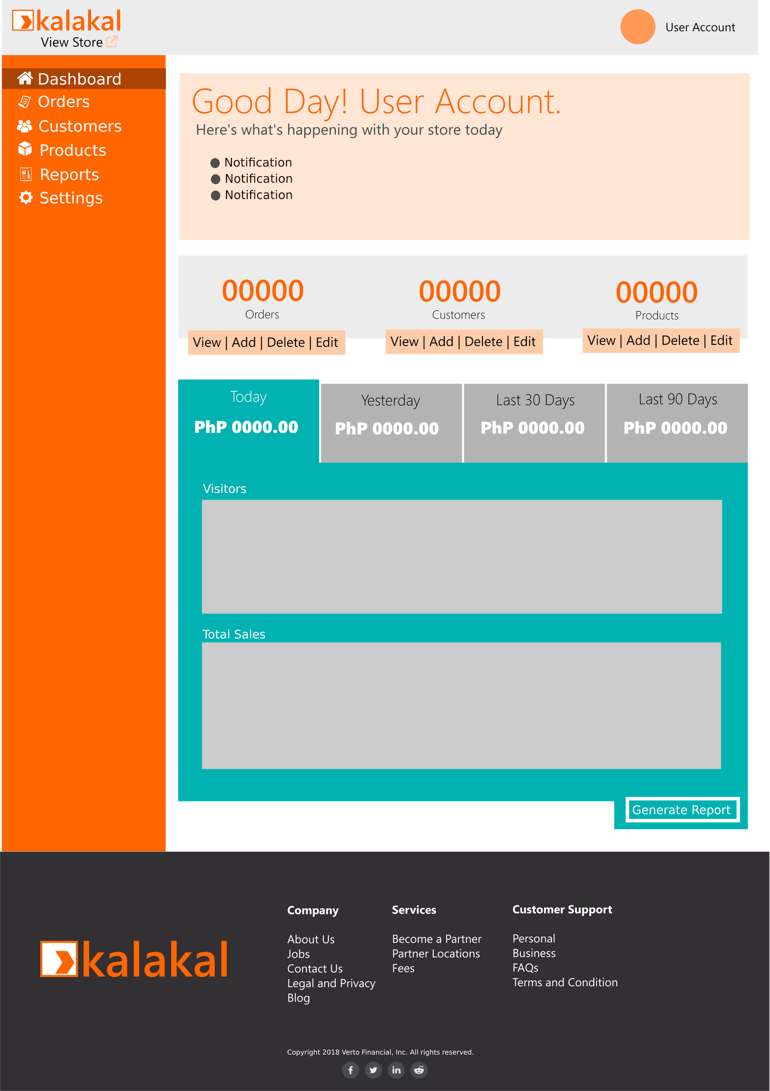
Kalakal Dashboard - Vendors

Slide 34
Kalakal Dashboard - Vendors

Slide 35
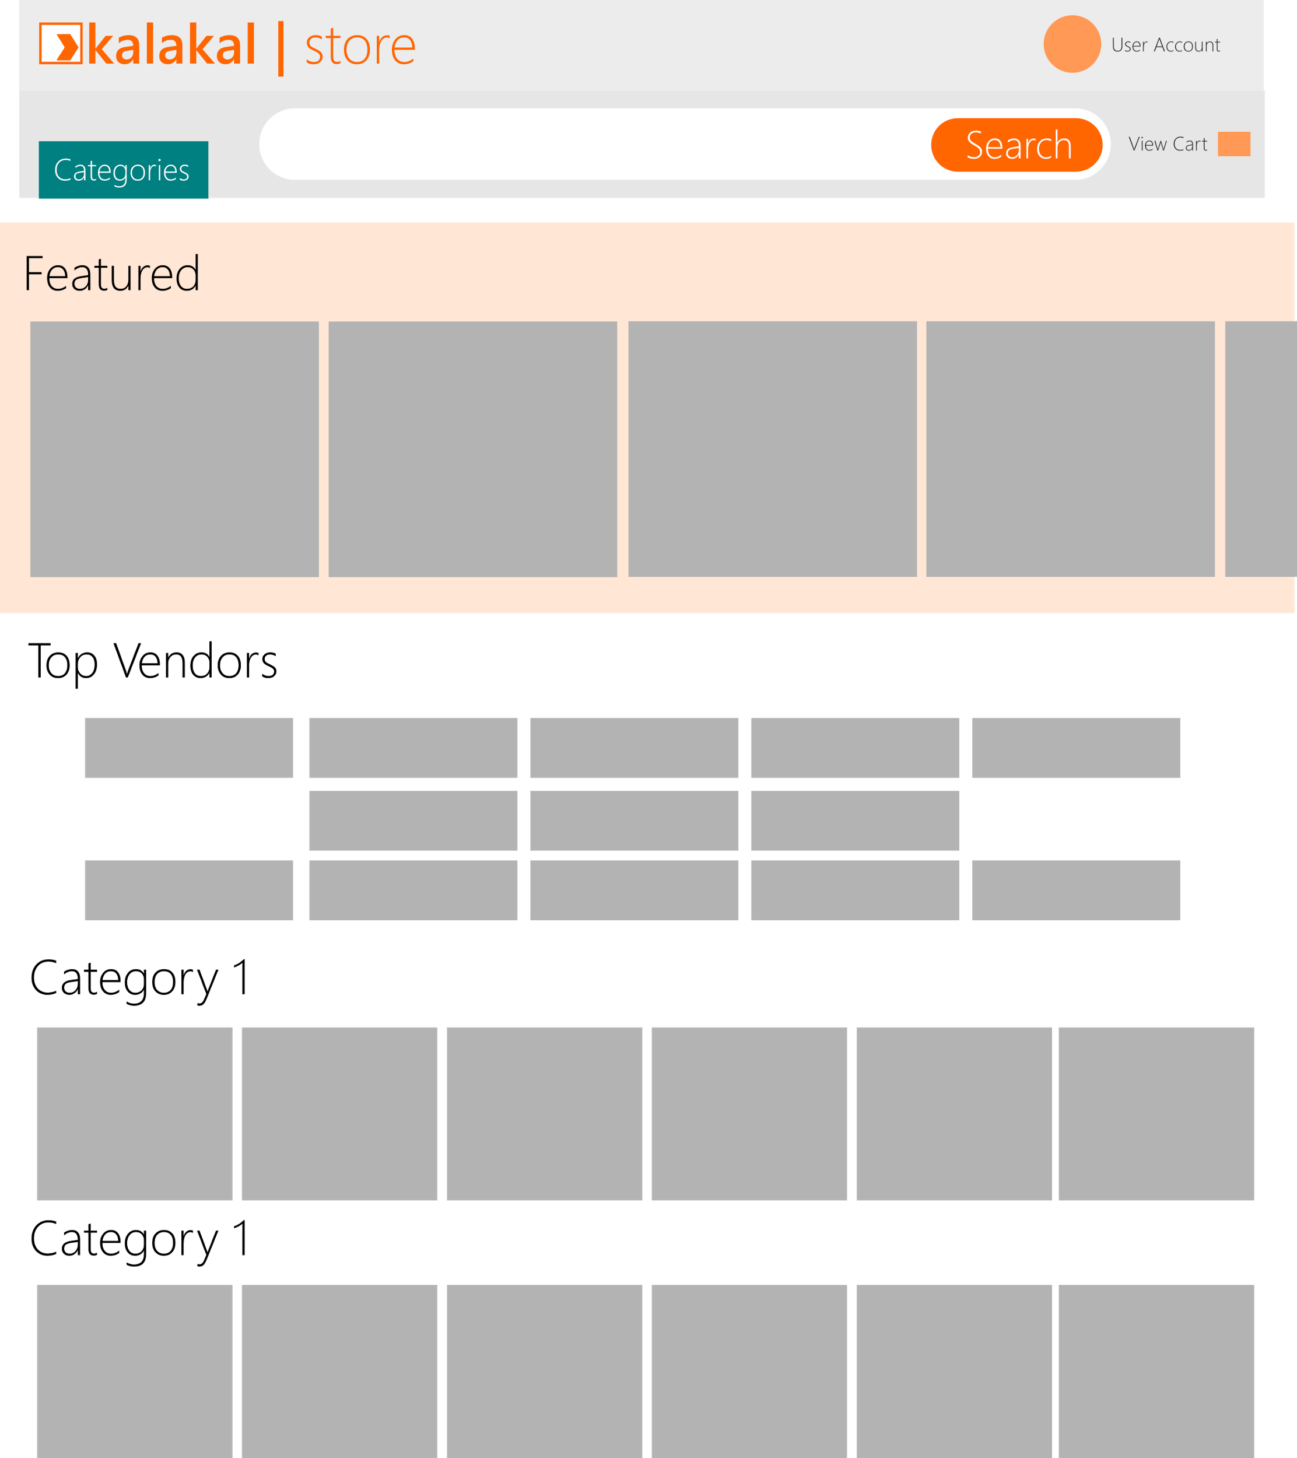
Kalakal Store - Customers

Slide 36
Kalakal Store - Customers

Slide 37
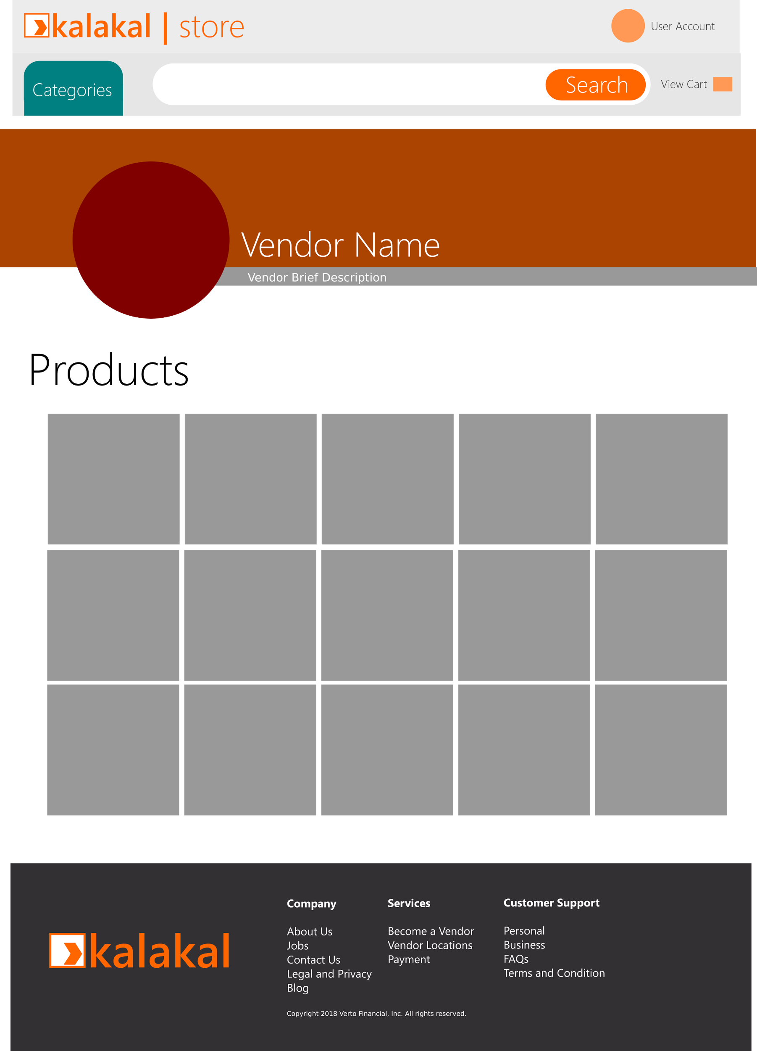
Kalakal Store - Vendor

Slide 38
Kalakal Store - Vendor

